Slide 1

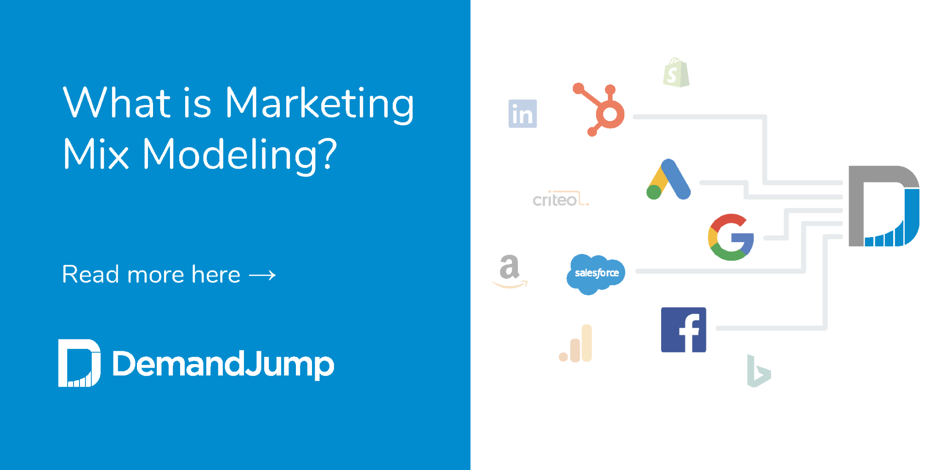
MARKET MIX MODELING

Slide 2


Agenda
Marketing Mix Modelling
Problem Statement
Dataset
Approach
Process Flow
Carryover & Saturation Effect
Sales Contribution by Channel
Questions
Disclaimer: The information transmitted by this presentation is intended for the person or entity to which it is addressed. This presentation may contain confidential information. Please note that any use or circulation of this presentation is not permitted.

Slide 3
Intro to MMX
Process Flow
Data Exploration
Model Output
Disclaimer: The information transmitted by this presentation is intended for the person or entity to which it is addressed. This presentation may contain confidential information. Please note that any use or circulation of this presentation is not permitted.

Slide 4
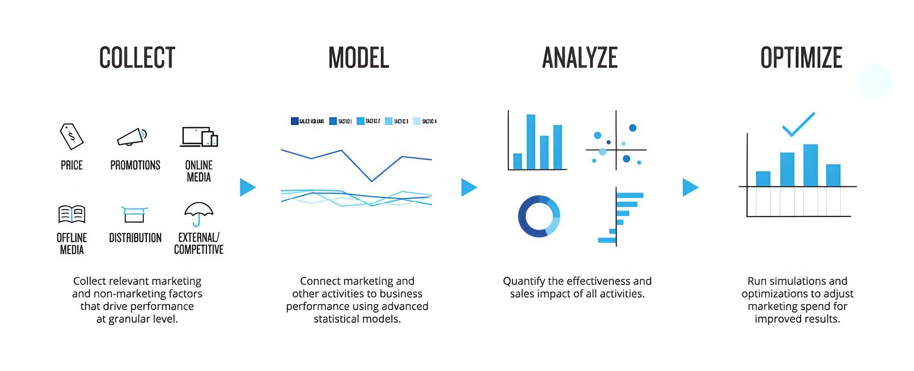
Marketing Mix Modelling
It is an analytical approach that uses historical information, such as syndicated point-of-sale data and companies’ internal data, to estimate the effectiveness of various marketing initiatives in increasing Return on Investment (ROI). It is often used to optimize advertising mix and promotional tactics with respect to sales revenue or profit.
Disclaimer: The information transmitted by this presentation is intended for the person or entity to which it is addressed. This presentation may contain confidential information. Please note that any use or circulation of this presentation is not permitted.

Slide 5
Problem Statement
To create a market mix model for the burger sales by interpreting the marketing spends of the following six marketing channels since 2020 .
INSTAGRAM
FACEBOOK
GOOGLE
BING
PINTREST
TIKTOK
During the market mix modeling there are many use cases that can be addressed which can help in making beneficial business decisions
Market Mix Model
Channel wise sales contribution
Decay, Carryover & Saturation
Measuring Marketing Effectiveness- ROI
Marketing Budget Forecasting
Percentage Attributable
Disclaimer: The information transmitted by this presentation is intended for the person or entity to which it is addressed. This presentation may contain confidential information. Please note that any use or circulation of this presentation is not permitted.

Slide 6
Intro to MMX
Process Flow
Data Exploration
Model Output
Disclaimer: The information transmitted by this presentation is intended for the person or entity to which it is addressed. This presentation may contain confidential information. Please note that any use or circulation of this presentation is not permitted.

Slide 7
Approach
Multivariate Regression Model
Dependent Variable -
Collecting the Business data and market research about the business model.
Data Pre-processing, EDA and Visualization
Data Preprocessing and EDA. Data Visualization and insight analysis.
Data Modeling, ROI, Lag, Saturation, Computation
Running the LR model and tuning the hyperparameters for computing the ROI, Carryover Effect, Saturation
Model Interpretation
Evaluating the model assumption and finding of the optimized budget allocation
75%
90%
45%
Disclaimer: The information transmitted by this presentation is intended for the person or entity to which it is addressed. This presentation may contain confidential information. Please note that any use or circulation of this presentation is not permitted.

Slide 8
Dataset
Period - Jan 2020 - May 2022
850 Data points
01
BURGER SALES (Dependant Variable)
Min : 950 Max : 14880
Mean: 5552 Std : 3475
02
INSTAGRAM DAILY SPENDS
Min : 0 Max : 31764
Mean: 1533 Std : 3225
03
BING DAILY SPENDS
Min : 0 Max : 100594
Mean: 8811 Std : 13524
04
FACEBOOK DAILY SPENDS
Min : 0 Max : 220378
Mean: 9399 Std : 19097
05
GOOGLE DAILY SPENDS
Min : 1384 Max : 414996
Mean: 83312 Std : 90478
06
PINTREST DAILY SPENDS
Min : 0 Max : 25803
Mean: 190 Std : 2100
07
TIKTOK DAILY SPENDS
Min : 0 Max : 37642
Mean: 7892 Std : 7892
Disclaimer: The information transmitted by this presentation is intended for the person or entity to which it is addressed. This presentation may contain confidential information. Please note that any use or circulation of this presentation is not permitted.

Slide 9
Intro to MMX
Process Flow
Data Exploration
Model Output
Disclaimer: The information transmitted by this presentation is intended for the person or entity to which it is addressed. This presentation may contain confidential information. Please note that any use or circulation of this presentation is not permitted.

Slide 10
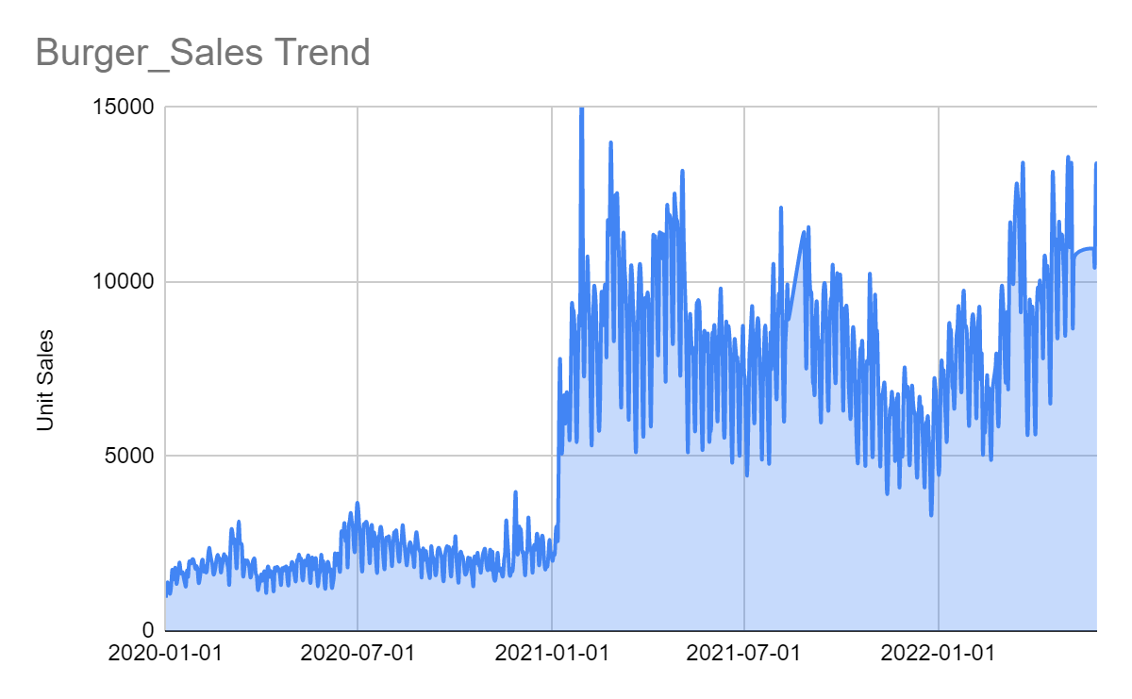
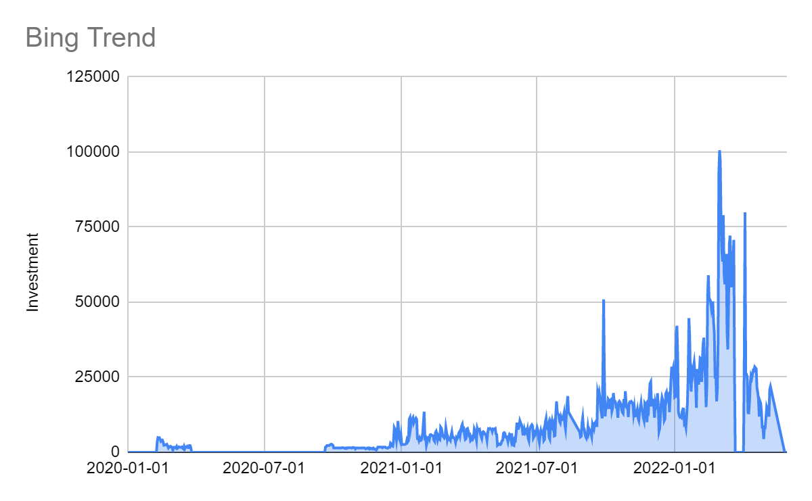
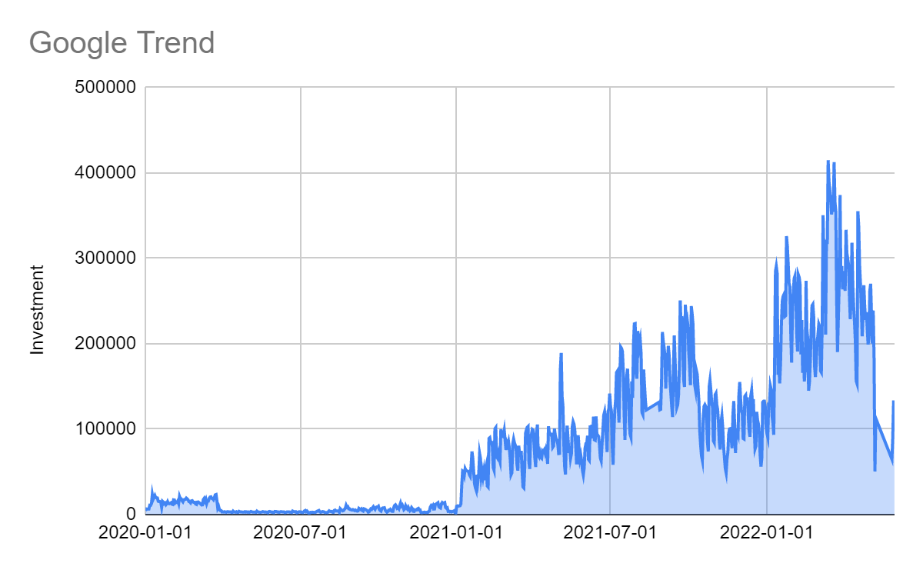
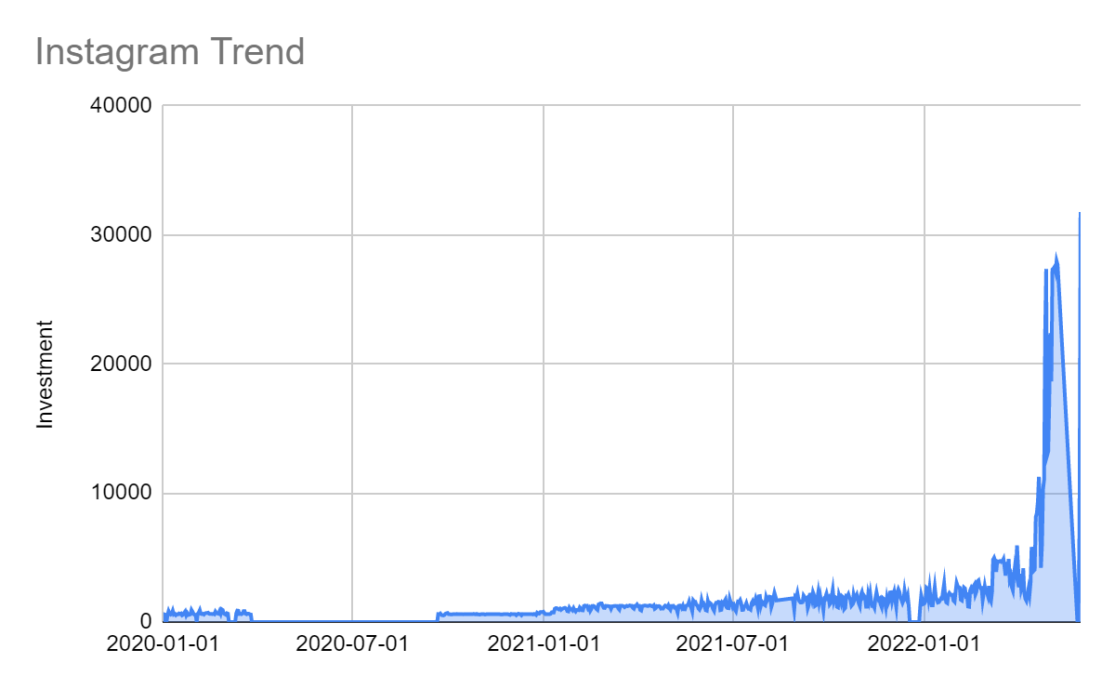
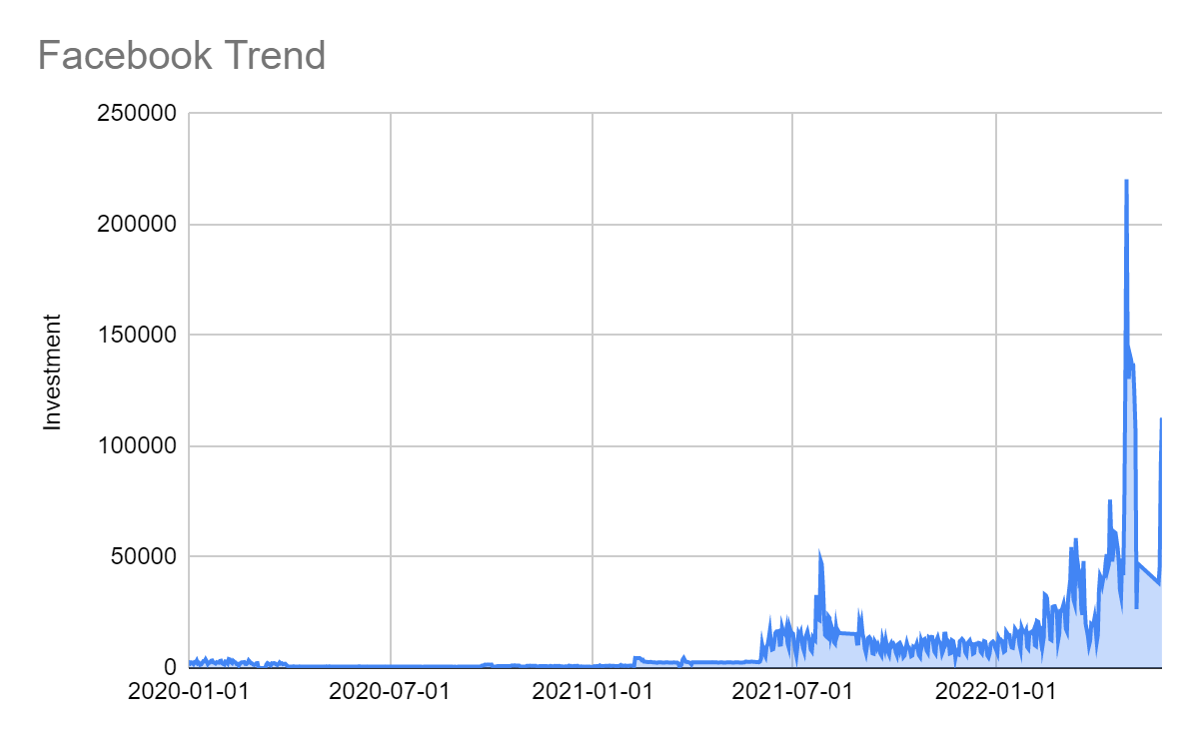
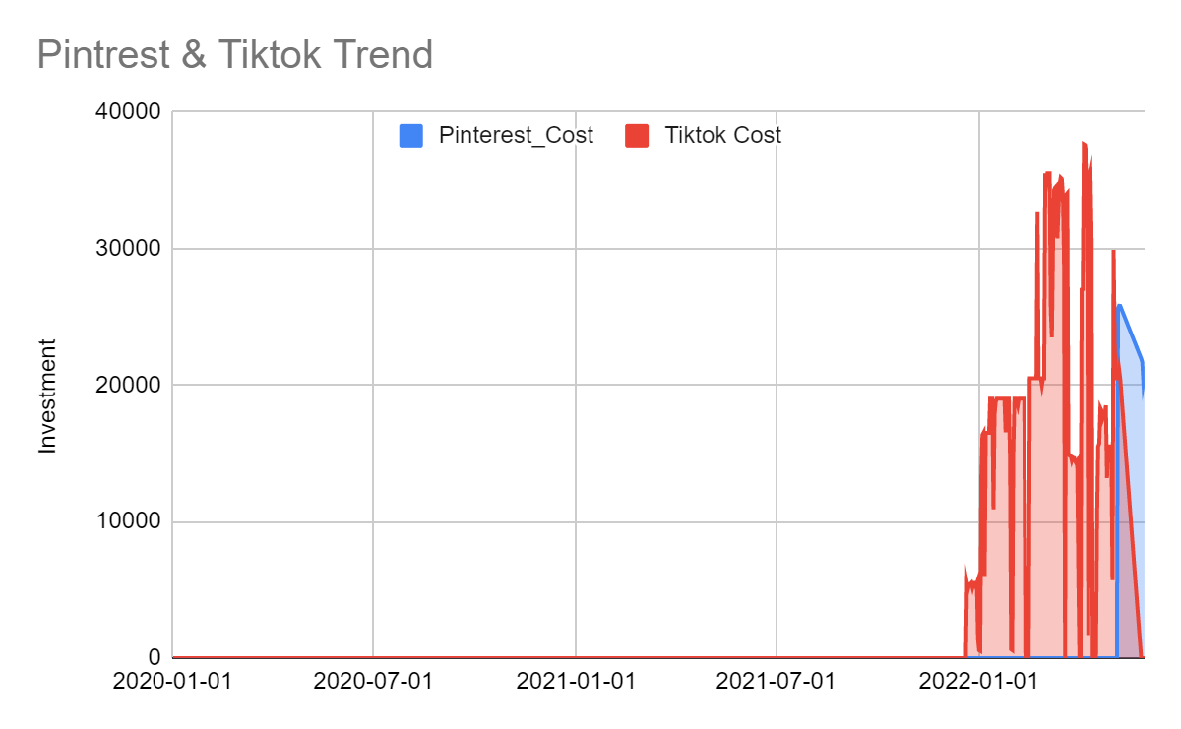
Trend of Sales & Marketing Spend
In 2020 the marketing spending was fairly low as compared to 2021 and this translates in the burger sales too.
This can be observed as a direct relation to minimum amount of total investment in marketing channel.
There is a pattern in the sales of the burger that the sales are cyclic and mostly dipping in the weekend.
Disclaimer: The information transmitted by this presentation is intended for the person or entity to which it is addressed. This presentation may contain confidential information. Please note that any use or circulation of this presentation is not permitted.

Slide 11
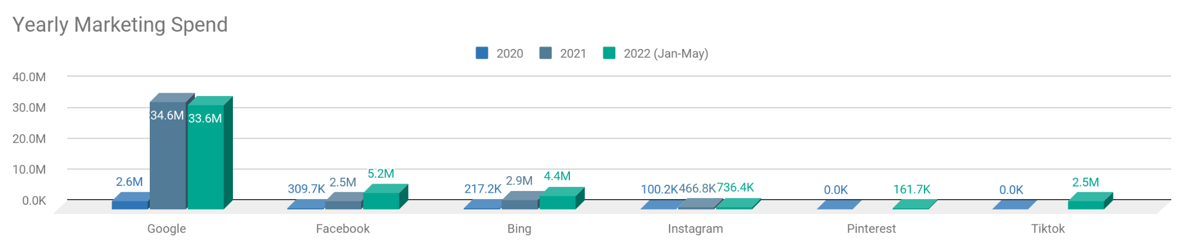
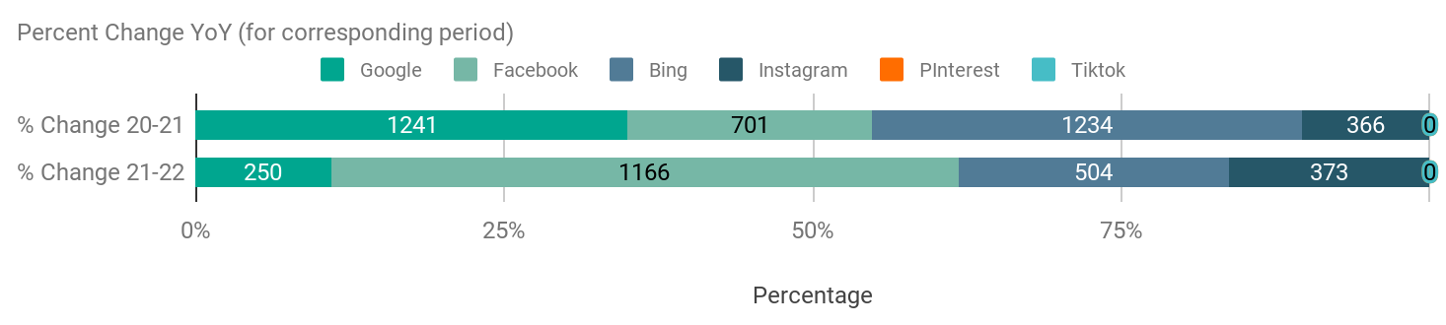
Annual Distribution of the Marketing Spend
The channels witnessed a surge in spending with Google and Bing leading with 1200% Increase, this extravagant spend tapered to 69 & 126 percent respectively..
Instagram has been a laggard in budget allocation.
Disclaimer: The information transmitted by this presentation is intended for the person or entity to which it is addressed. This presentation may contain confidential information. Please note that any use or circulation of this presentation is not permitted.
Notes:
Period wise for 2022

Slide 12
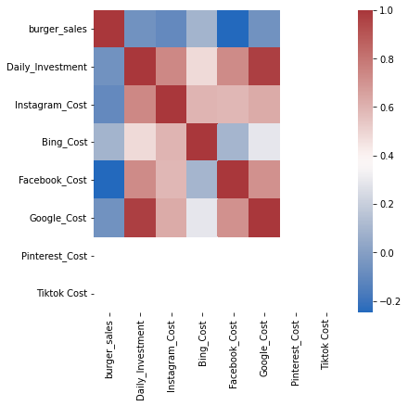
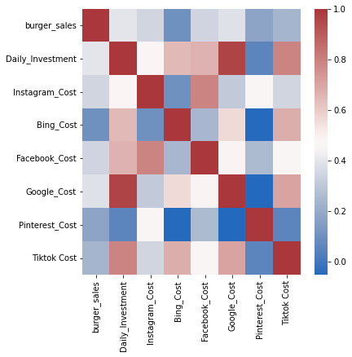
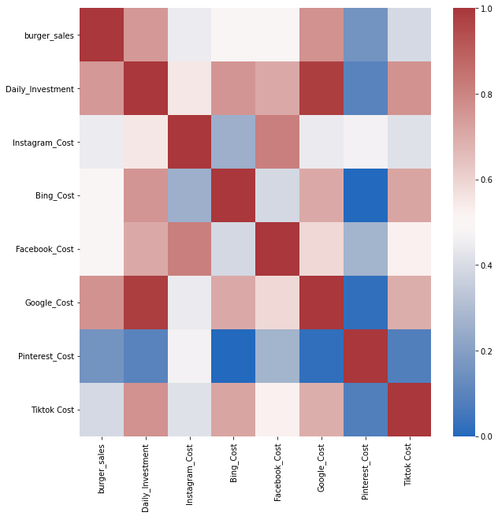
Sales correlation with the Marketing spends
Heat Map of 2020
Heat Map of 2021 Onwards
Heat Map of Entire Data
In 2020 Burger Sales had negative correlation with facebook (-0.2) and relatively low with the rest of channels
2021-2022 Burger Sales had relatively moderate correlation wrt 2020 and very low with Bing & Pintrest channels
We notice that Burger Sales have medium ~0.5 correlation with Instagram, Bing and Facebook and higher correlation with google.
Disclaimer: The information transmitted by this presentation is intended for the person or entity to which it is addressed. This presentation may contain confidential information. Please note that any use or circulation of this presentation is not permitted.

Slide 13
Intro to MMX
Process Flow
Data Visualization
Model Output
Disclaimer: The information transmitted by this presentation is intended for the person or entity to which it is addressed. This presentation may contain confidential information. Please note that any use or circulation of this presentation is not permitted.

Slide 14
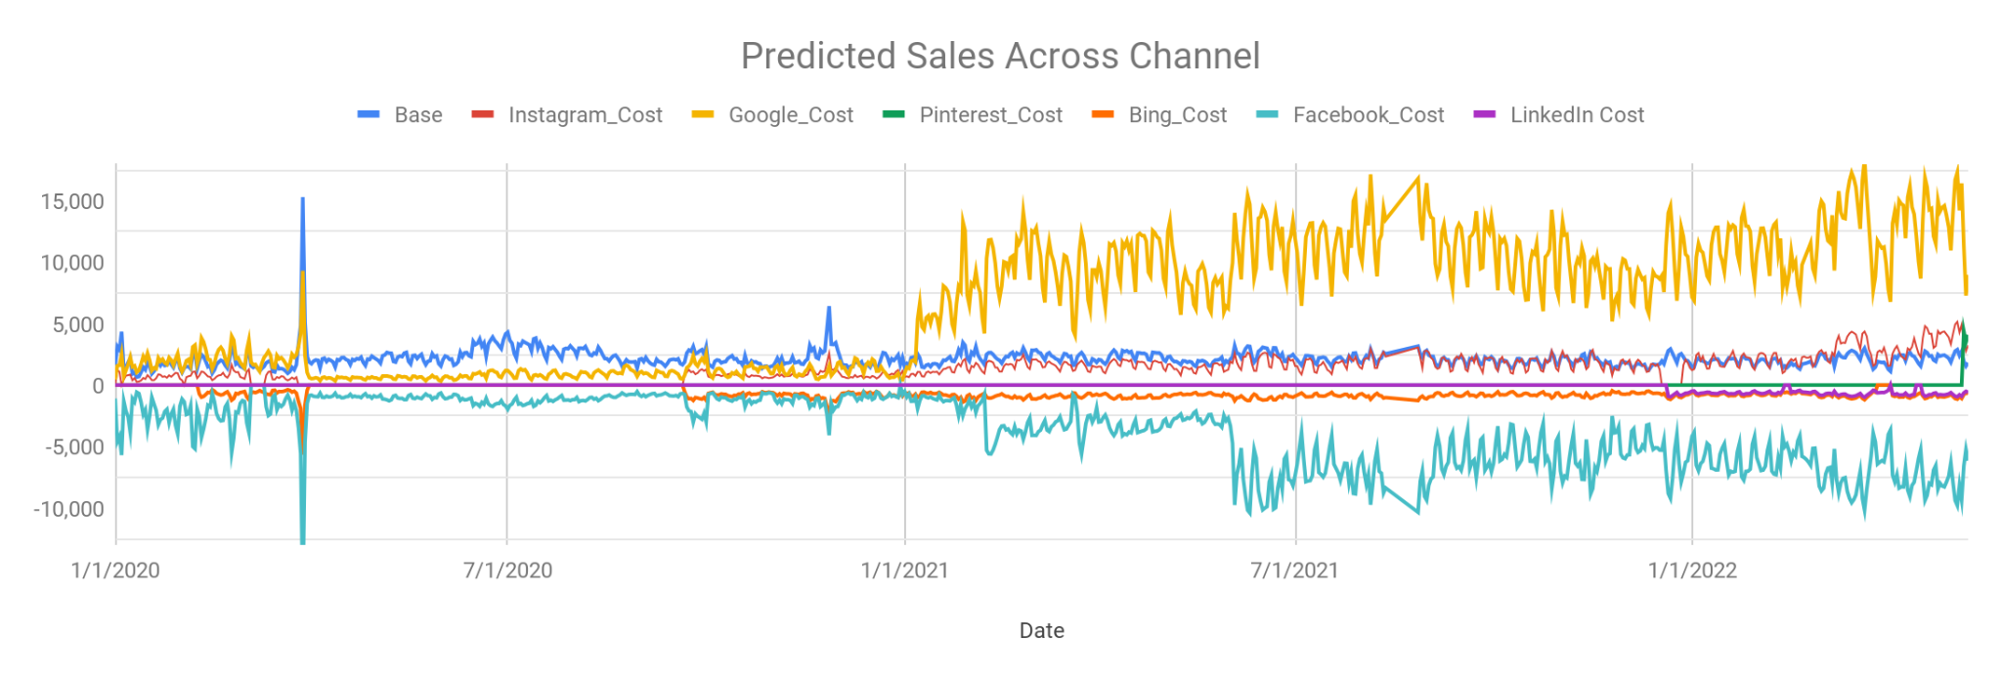
Channel wise Contribution
Google contributing the most post 2021 in correlation with the increase in marketing spendings
Facebook, Bing and Tiktok Channels were the negative contributors to sales
Base Sales following a sideways trend throughout.
Disclaimer: The information transmitted by this presentation is intended for the person or entity to which it is addressed. This presentation may contain confidential information. Please note that any use or circulation of this presentation is not permitted.

Slide 15
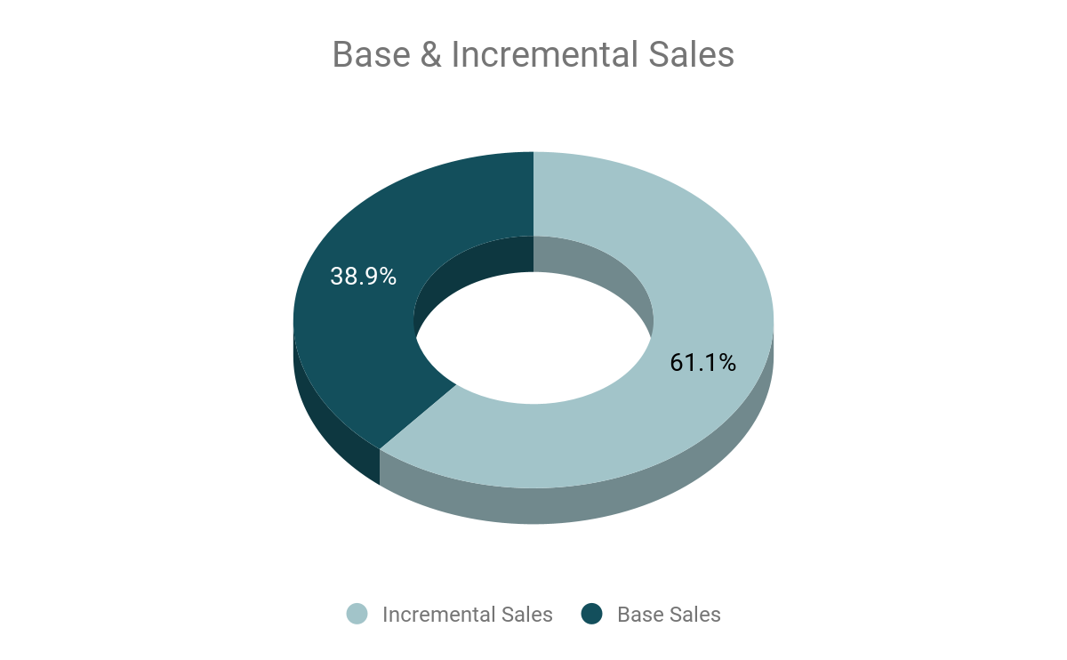
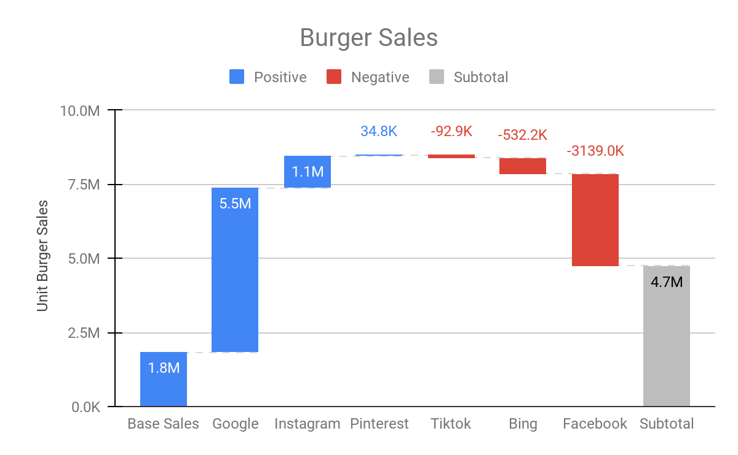
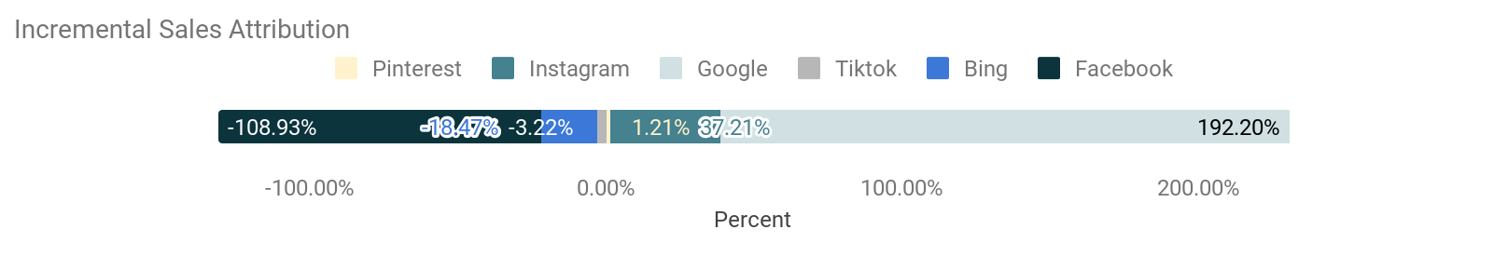
Channelwise Sales Contribution
Disclaimer: The information transmitted by this presentation is intended for the person or entity to which it is addressed. This presentation may contain confidential information. Please note that any use or circulation of this presentation is not permitted.

Slide 16
Channelwise Sales Contribution
Disclaimer: The information transmitted by this presentation is intended for the person or entity to which it is addressed. This presentation may contain confidential information. Please note that any use or circulation of this presentation is not permitted.

Slide 17
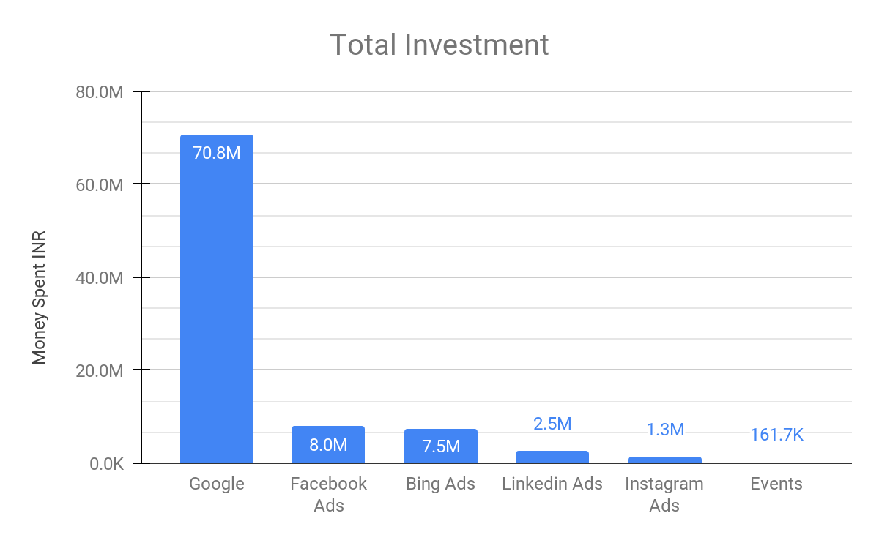
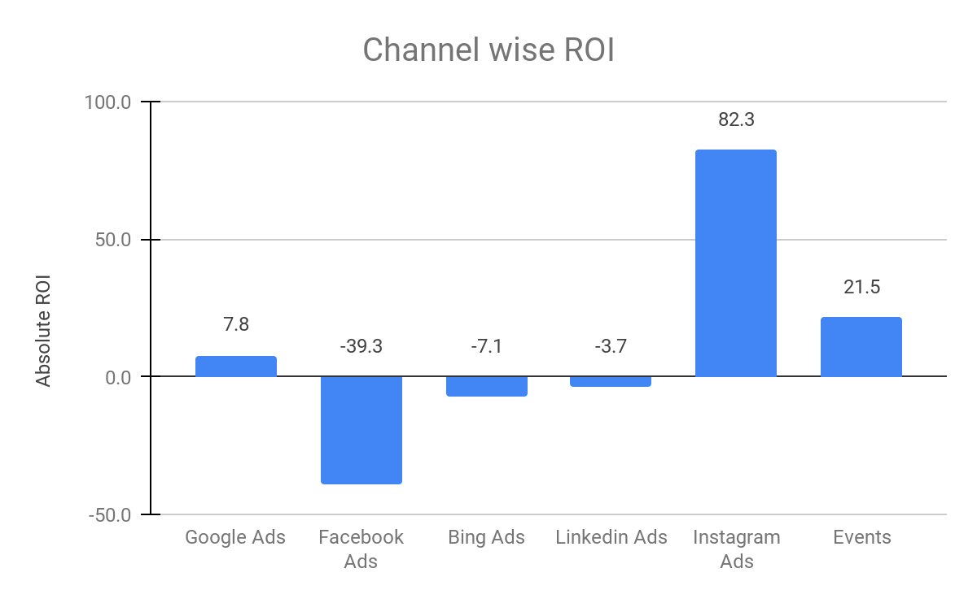
Channel wise ROI
ROI = Net Sales from the Channel x Avg Cost of Burger
Net Investment in Channel
Disclaimer: The information transmitted by this presentation is intended for the person or entity to which it is addressed. This presentation may contain confidential information. Please note that any use or circulation of this presentation is not permitted.
Notes:
Custom format and 3d removal

Slide 18
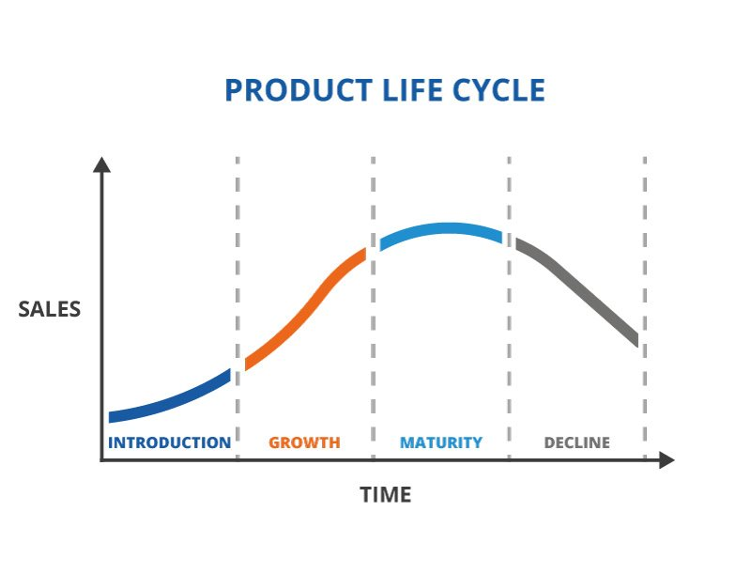
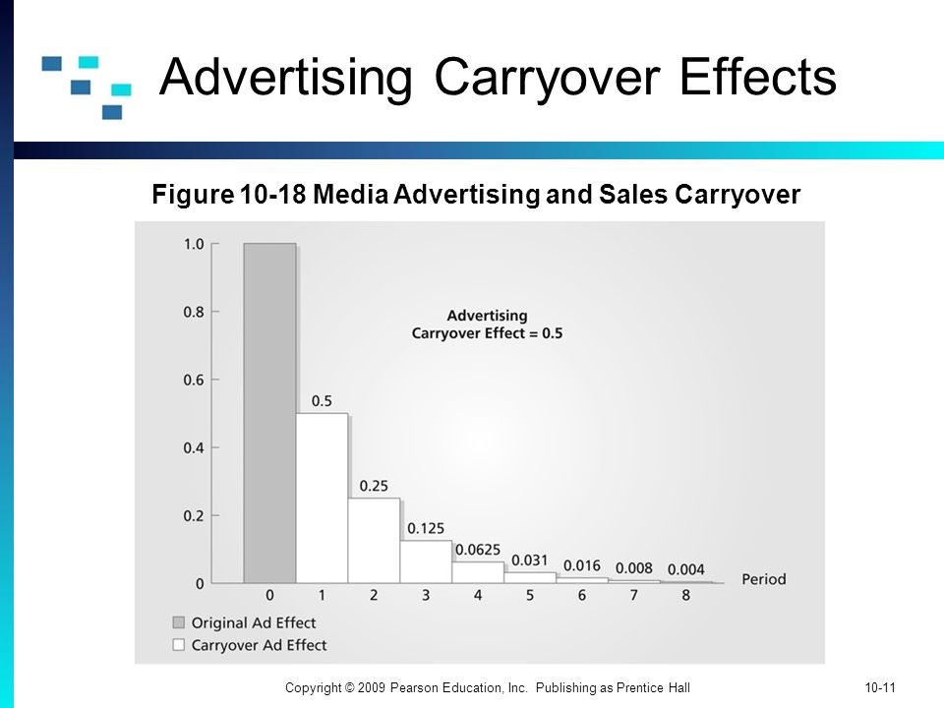
Carryover & Saturation Effect
Carryover Effect - The rate at which the effectiveness of an advertising campaign diminishes with time
Saturation Effect - A point where sales reach a limit after which more advertising has near zero incremental effect.
Ad Carryover Effect
Marketing saturation Cycle
Sales
Spending & Time
Disclaimer: The information transmitted by this presentation is intended for the person or entity to which it is addressed. This presentation may contain confidential information. Please note that any use or circulation of this presentation is not permitted.

Slide 19
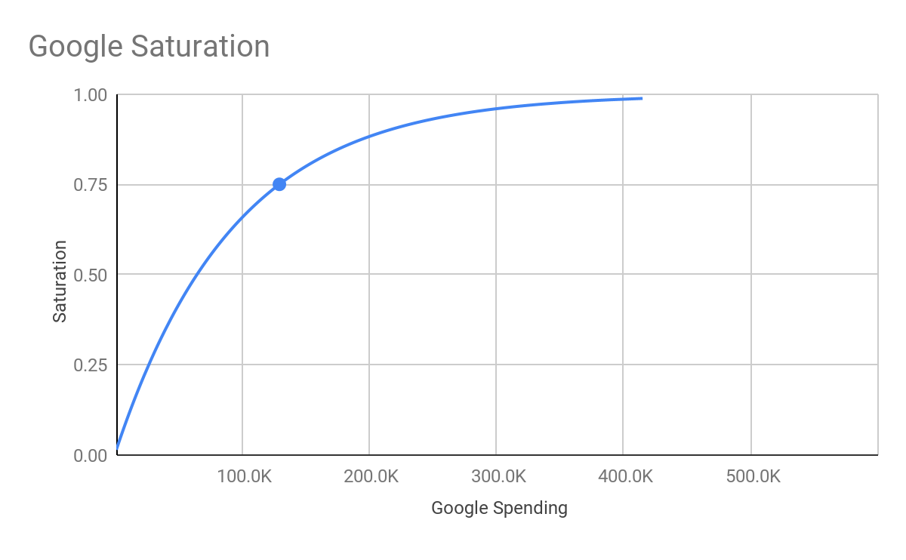
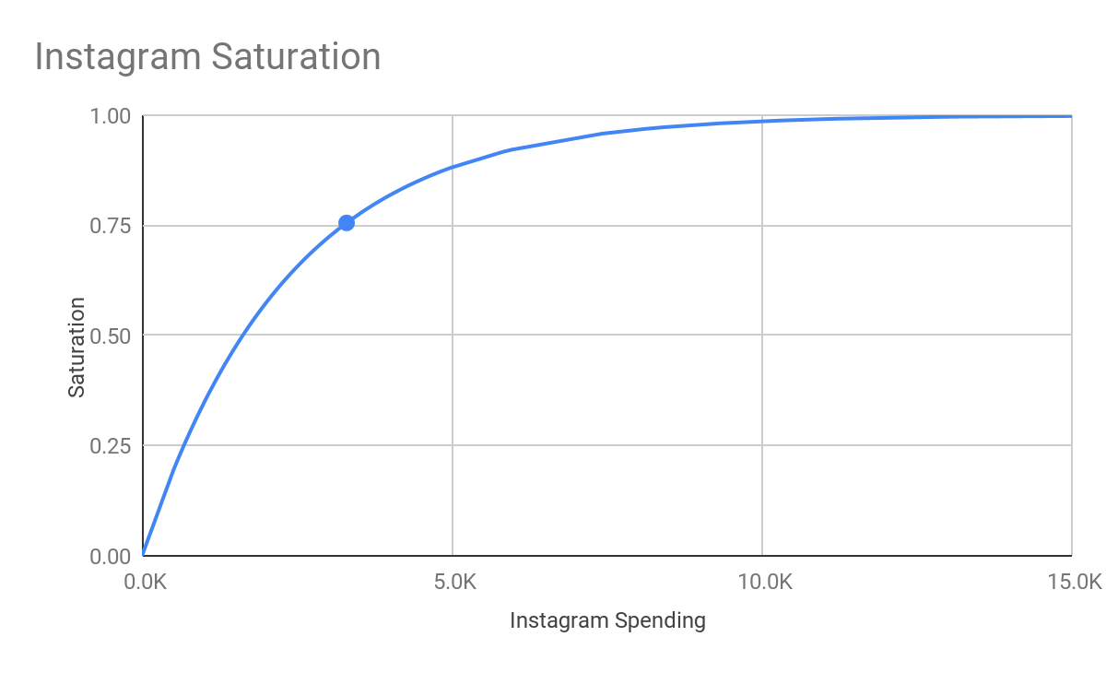
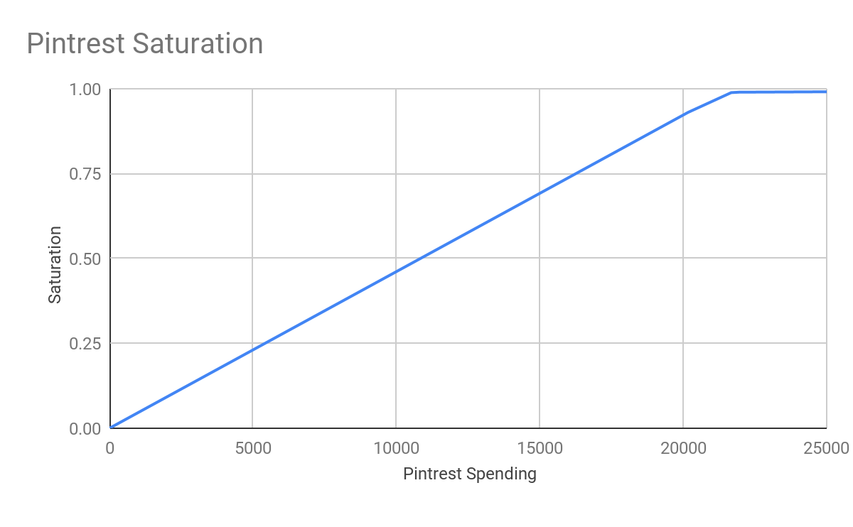
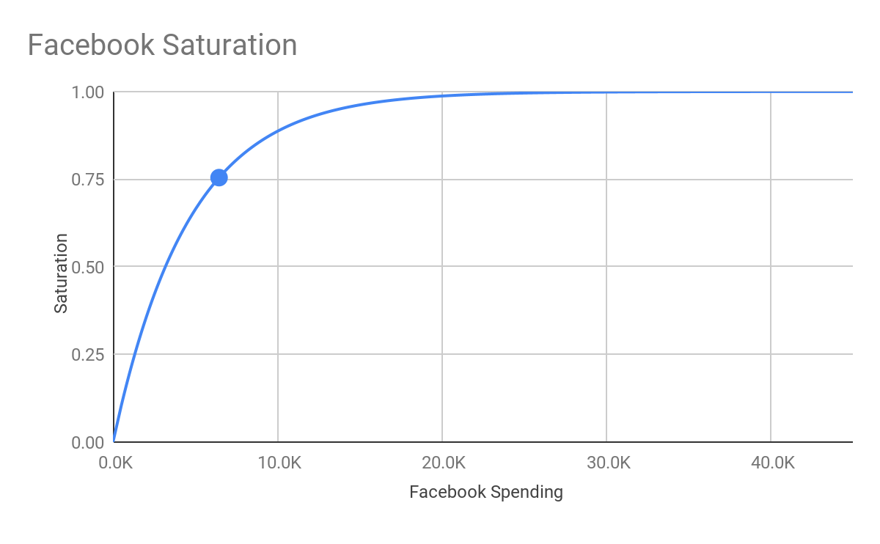
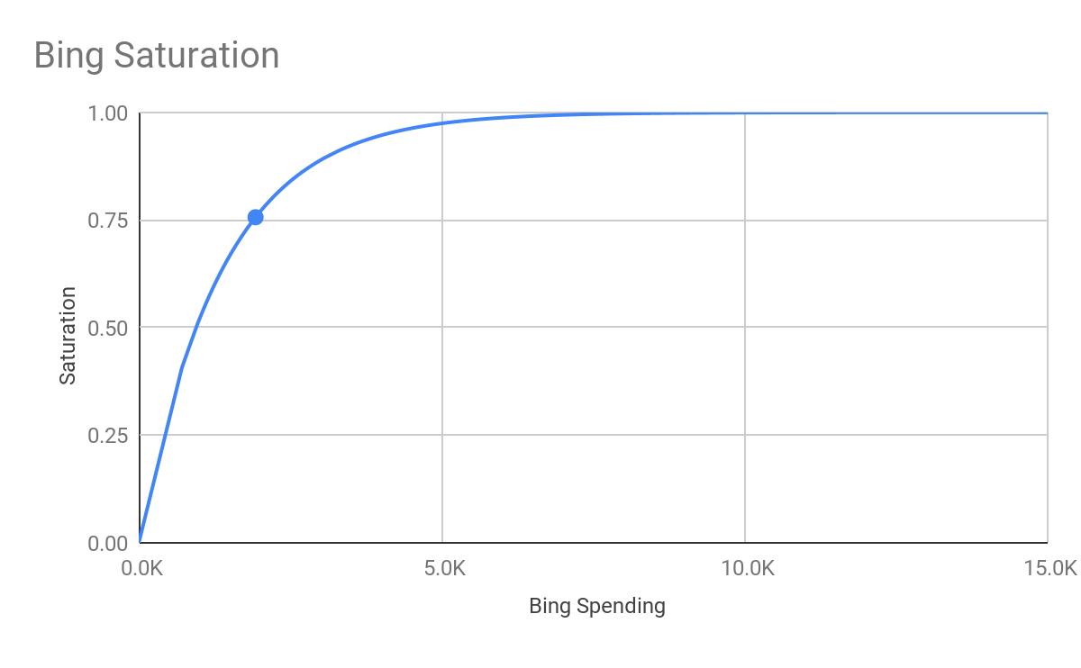
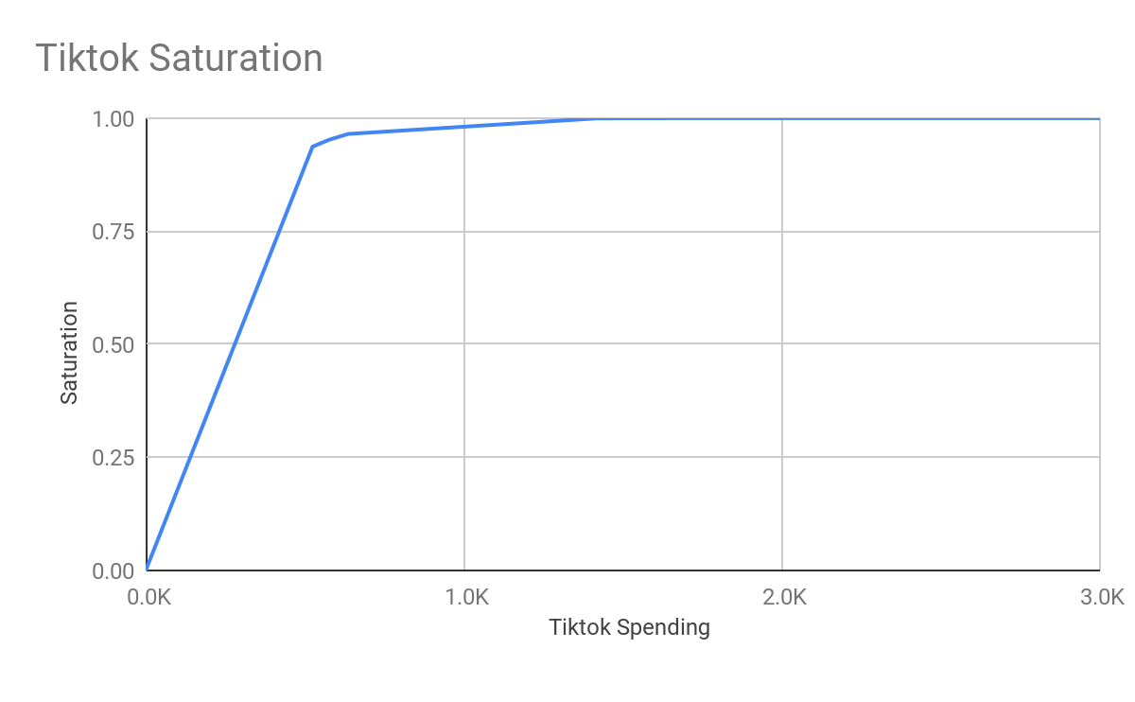
Saturation Effect
Google is close to saturation, whilst others have reached saturation, Tiktok saturating earliest
22 Days- 11 Million
22 Days-
0.4 Million
5 Days-
120k
312 Days-
5.3 Millions
85 Days-
5.2 Millions
4 Days-
120k
Disclaimer: The information transmitted by this presentation is intended for the person or entity to which it is addressed. This presentation may contain confidential information. Please note that any use or circulation of this presentation is not permitted.
Notes:
Per day cost depicted in the saturation graphs - showing the sweet spot of spend -

Slide 20
Saturation Effect
Google is close to saturation, whilst others have reached saturation, Tiktok saturating earliest
22 Days-
11 Million
22 Days-
0.4 Million
5 Days-
120k
312 Days-
5.3 Millions
85 Days-
5.2 Millions
4 Days-
120k
Disclaimer: The information transmitted by this presentation is intended for the person or entity to which it is addressed. This presentation may contain confidential information. Please note that any use or circulation of this presentation is not permitted.
Notes:
Summing up the Excess spends, it turns out to 22 Million, Investing this much amount into channels with higher ROI would yield

Slide 21
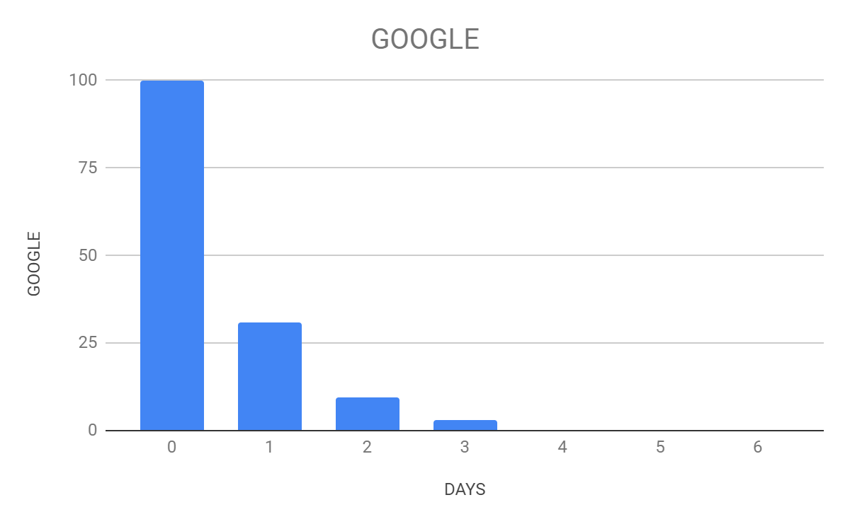
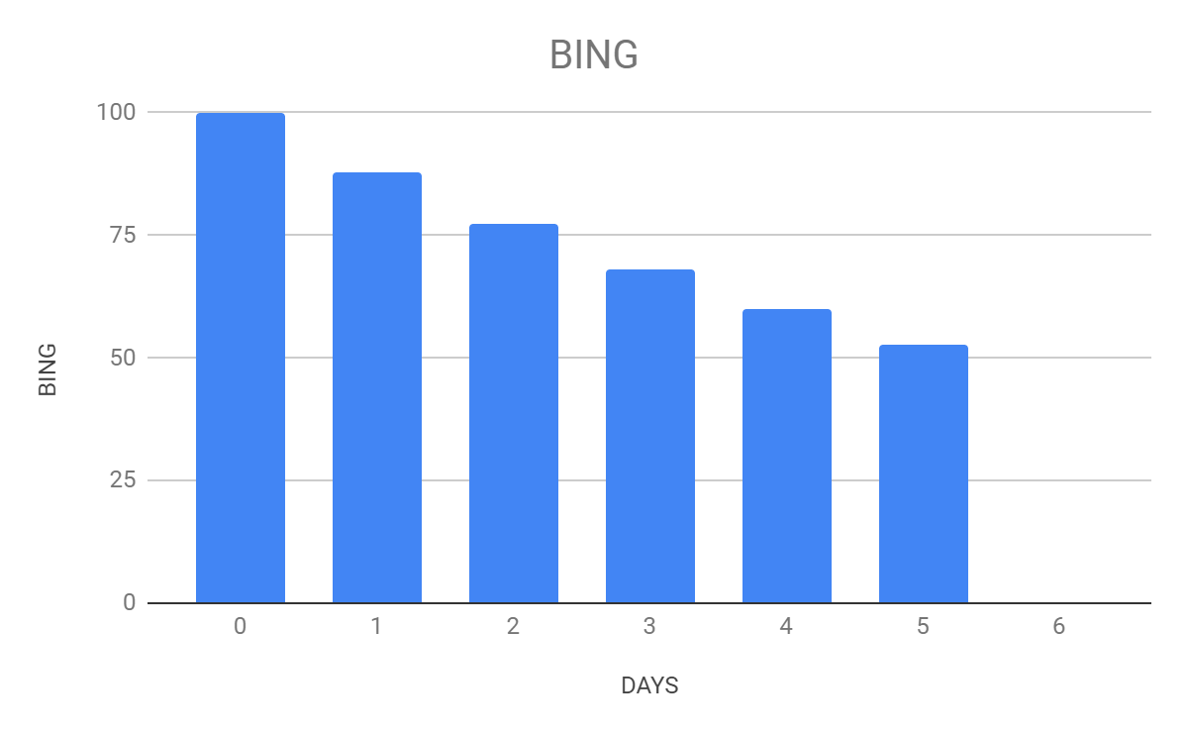
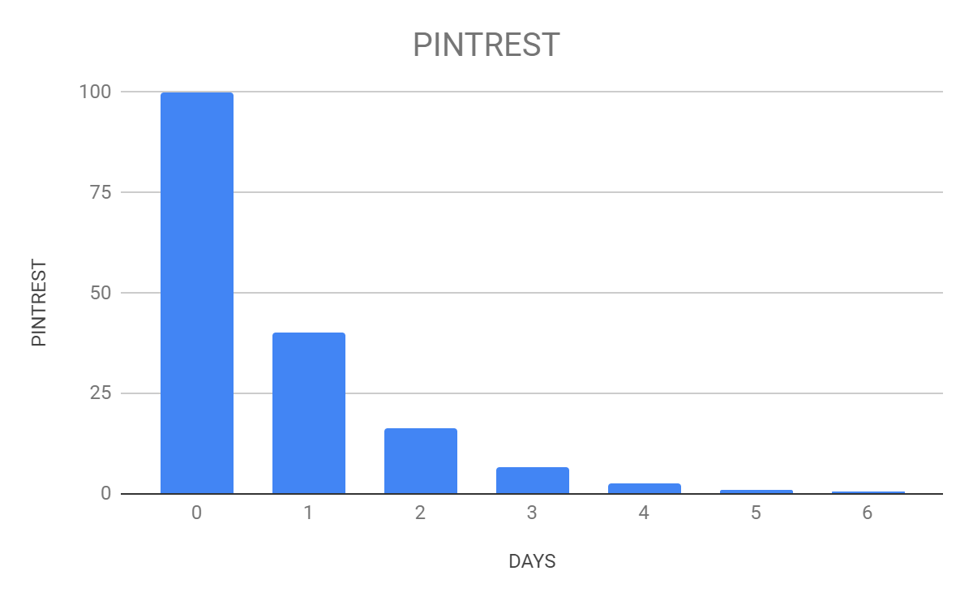
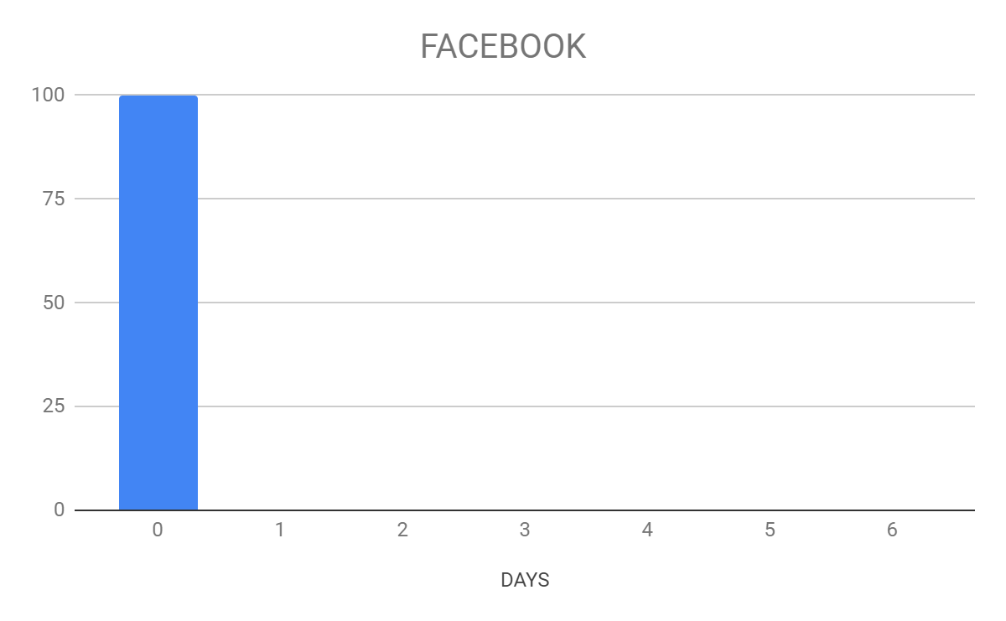
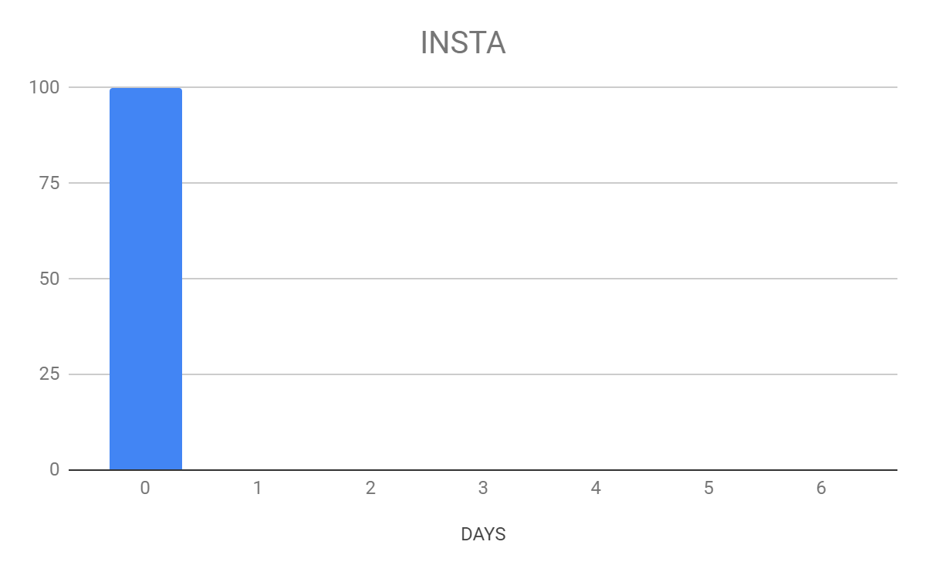
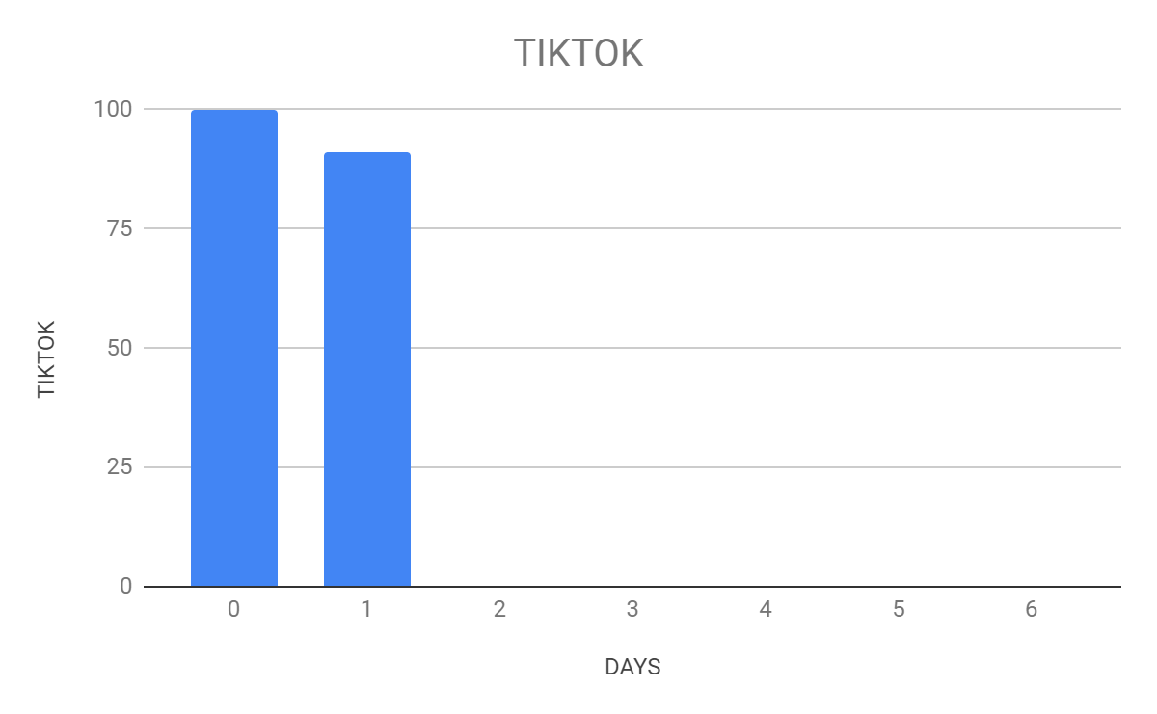
Carryover Effect
- Pintrest and Bing show carryover effect upto 6 days, whilst Google upto 3 days
Disclaimer: The information transmitted by this presentation is intended for the person or entity to which it is addressed. This presentation may contain confidential information. Please note that any use or circulation of this presentation is not permitted.

Slide 22
Carryover Effect
- Pintrest and Bing show carryover effect upto 6 days, whilst Google upto 3 days
Disclaimer: The information transmitted by this presentation is intended for the person or entity to which it is addressed. This presentation may contain confidential information. Please note that any use or circulation of this presentation is not permitted.

Slide 23
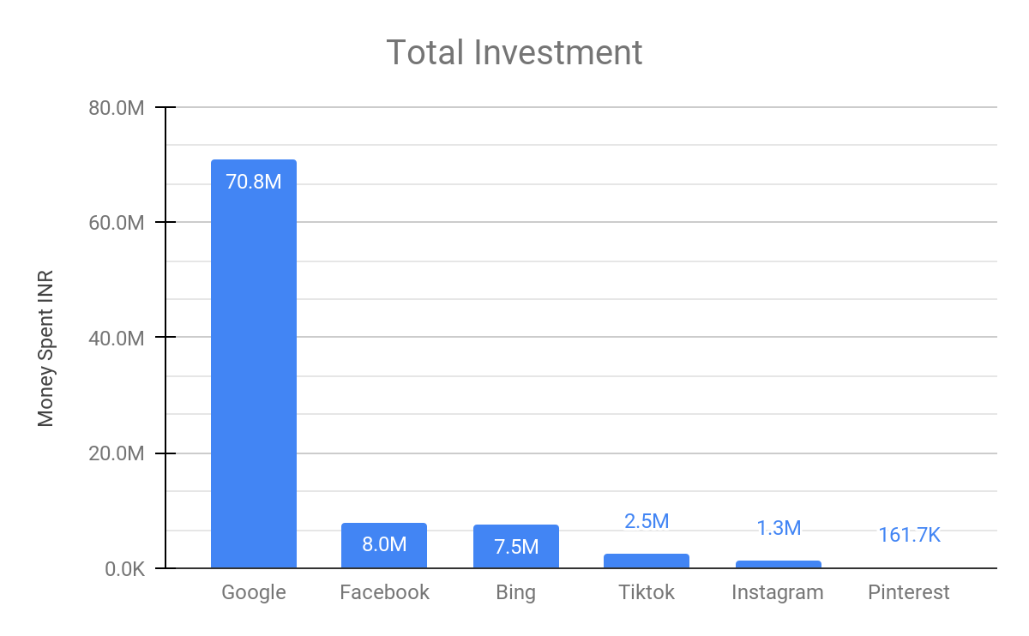
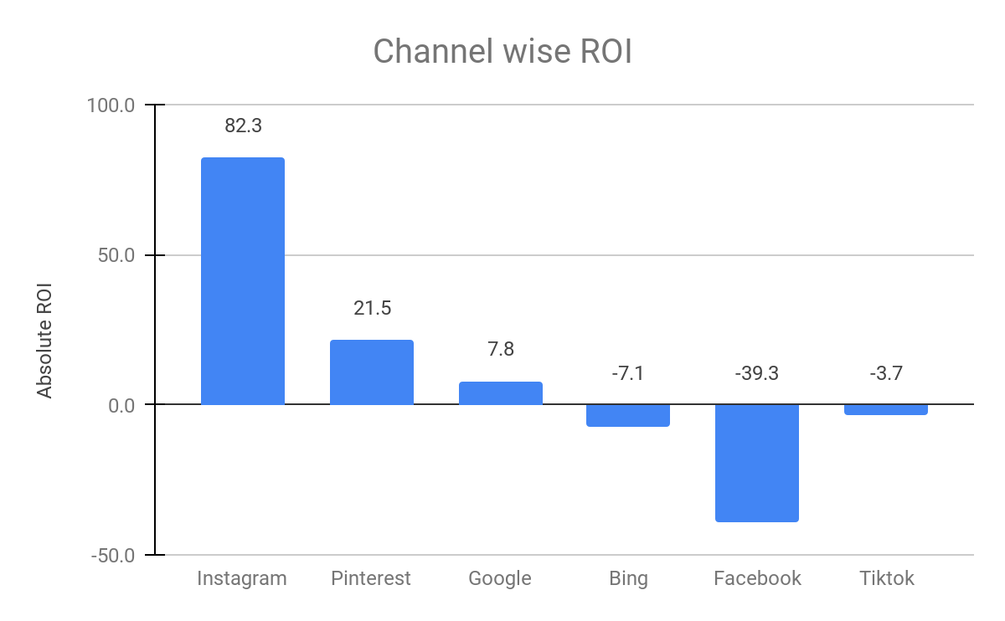
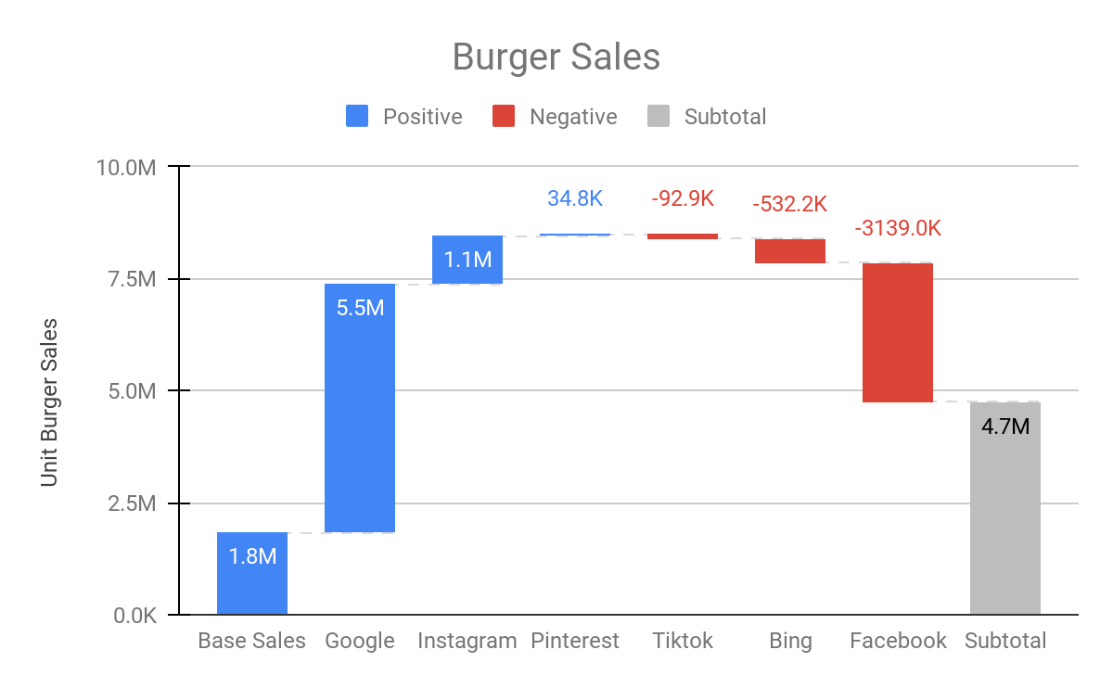
Recommendations
- According to the model savings worth INR 18 Million ,could have been achieved.
- We could have sold 3.7 million units of more Burger Sales.
- And had that money been invested into high ROI channels like Instagram and Pinterest the expected profits would have been been and used in Instagram and Pinterest then the profit would have been higher
Disclaimer: The information transmitted by this presentation is intended for the person or entity to which it is addressed. This presentation may contain confidential information. Please note that any use or circulation of this presentation is not permitted.
Notes:
1. On average, users spend more than 1.5 hours per day on TikTok
2. In Q2 of 2022, TikTok surpassed 1 billion monthly active users
3. 3.5 Billion Installations
4. 167 Million TikTok Videos Watched in an Internet Minute
5. Entertainment Most Popular Category on TikTok by Hashtag Views
6. About 18 million people in the US have downloaded TikTok from the Apple App Store
7. Second Most Popular iPhone App Downloaded in the U.S. in 2022
8. Most Popular Overall App Downloaded Globally
9. 150+ Countries
10. 75 (or 39 or 35+) Languages
11. Highest Social Media Engagement Rates Per Post
12. Over 200 Million TikTok Users in India When it Was Banned in 2020
13. Highly Popular in Many Asian Countries
14. 600 Million Active Daily Users in China
15. TikTok's Highest Reach (for Adults) is in Saudi Arabia

Slide 24
Thank you!
Notes:
Maneesh to handover

Slide 25
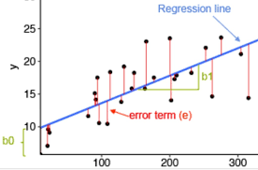
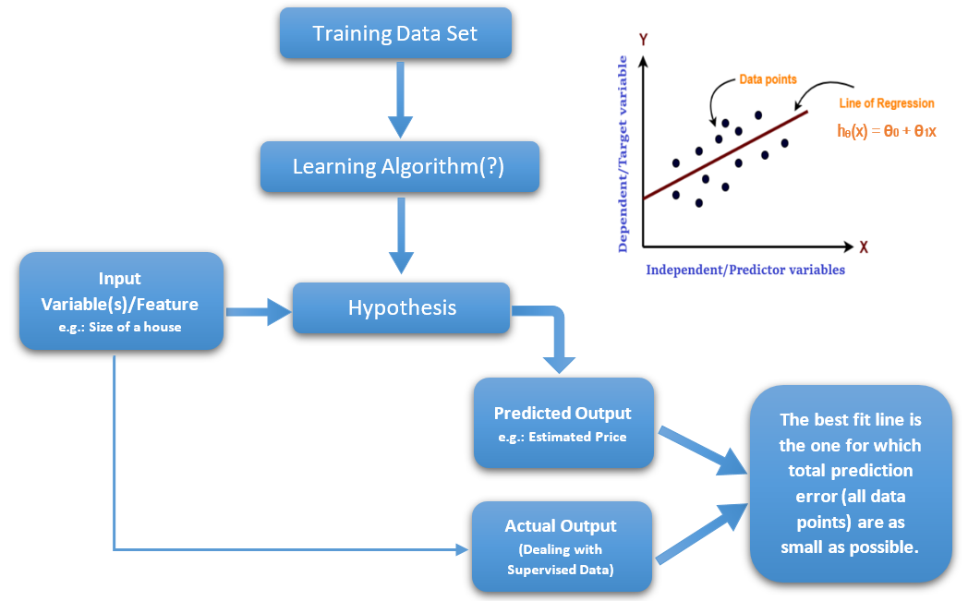
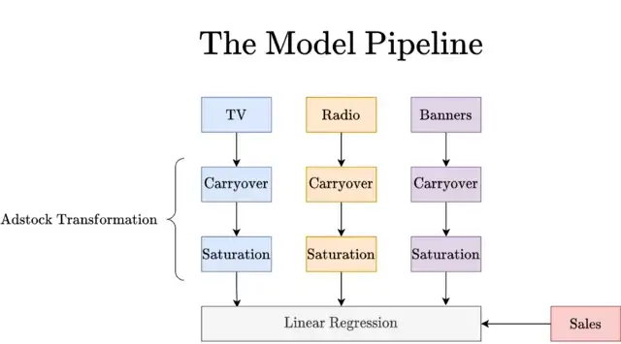
Linear Regression Synapsis
Sales = f(TV) + g(Radio) + h(Banners) + Base
Sales = 0.36 * TV + 0.49 * Radio + 1.23 * Banners + 6678.40
Disclaimer: The information transmitted by this presentation is intended for the person or entity to which it is addressed. This presentation may contain confidential information. Please note that any use or circulation of this presentation is not permitted.
Notes:
As we needed to decompose the sales easily, find the ROIs and optimize spending, which is what companies ultimately want so our natural choice for the same was LR modeling as models such as random forests, gradient boosting, or (plain and simple feed-forward) neural networks are not suitable here, as we cannot get such a decomposition out of them

Slide 26
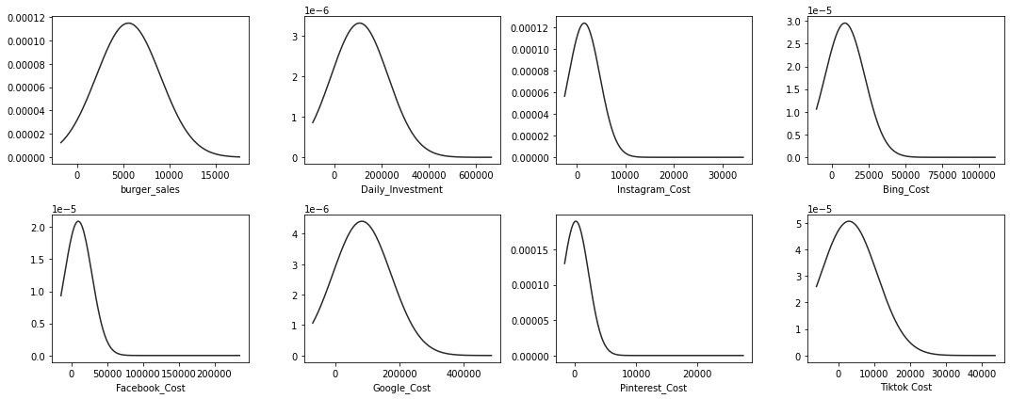
Distribution of Sales and Marketing Spends
The following graphs depicts that barring the Burger sales which is normally distributed, rest all the channels are right skewed.
Disclaimer: The information transmitted by this presentation is intended for the person or entity to which it is addressed. This presentation may contain confidential information. Please note that any use or circulation of this presentation is not permitted.

Slide 27
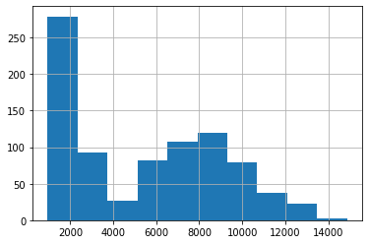
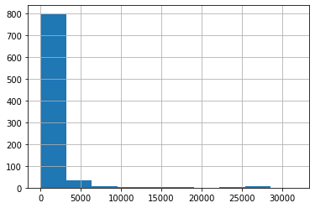
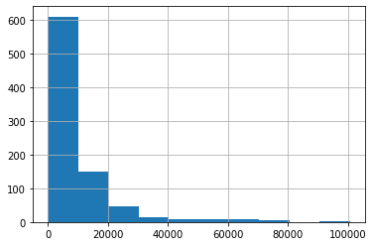
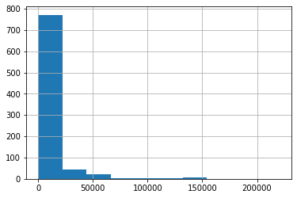
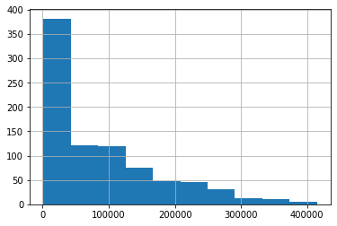
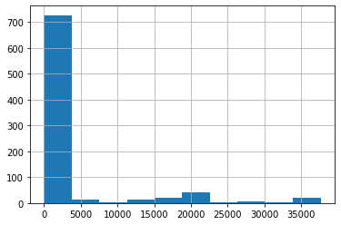
Histogram
Burger Sales
Instagram
Bing
Facebook
Google
Pintrest and Tiktok
Disclaimer: The information transmitted by this presentation is intended for the person or entity to which it is addressed. This presentation may contain confidential information. Please note that any use or circulation of this presentation is not permitted.

Slide 28

Data Visualization
Disclaimer: The information transmitted by this presentation is intended for the person or entity to which it is addressed. This presentation may contain confidential information. Please note that any use or circulation of this presentation is not permitted.

Slide 29
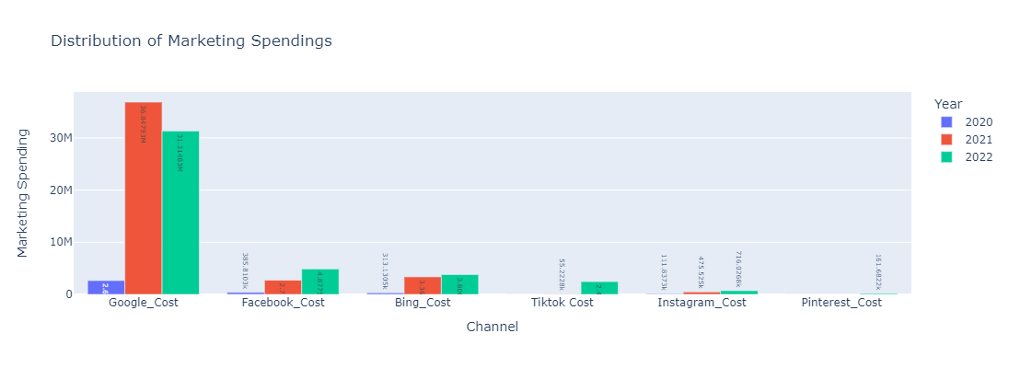
Distribution of the Marketing Spend
Over the Years Google spending have witnessed dip, as money is being allocated to TikTok and Pintrest.
Instagram has been a laggard in budget allocation.
Disclaimer: The information transmitted by this presentation is intended for the person or entity to which it is addressed. This presentation may contain confidential information. Please note that any use or circulation of this presentation is not permitted.

Slide 30
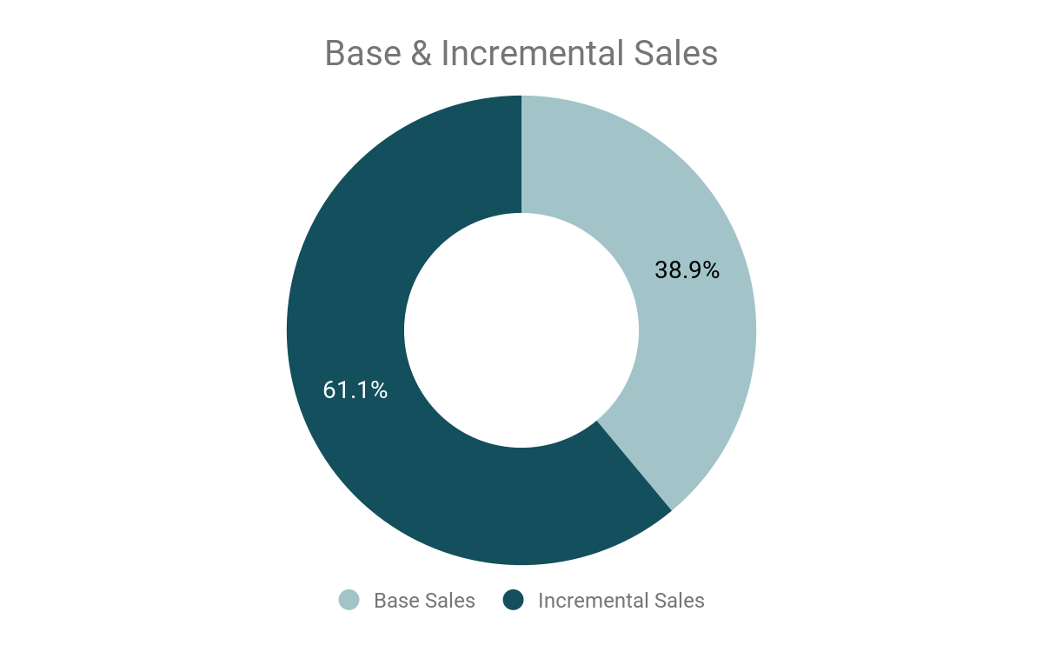
Channelwise Sales Contribution
The individual contribution of the marketing channels.
Disclaimer: The information transmitted by this presentation is intended for the person or entity to which it is addressed. This presentation may contain confidential information. Please note that any use or circulation of this presentation is not permitted.

Slide 31

Process Flow
Plugging the coefficients and the Intercept from the Hypertuned model to evaluate the Carryover, Saturation and ROI.
Splitting the data
Pipeline Creation
Scaling
Scaling
Feature Selection
Used Min max scaling to scale the data.
Creating the Pipeline and Transformers for the Carryover and Saturation effect.
Splitting
LR Modeling & Hypertunning
Material is copyright of Grazitti Interactive and cannot be shared without prior permission

